Slide 1
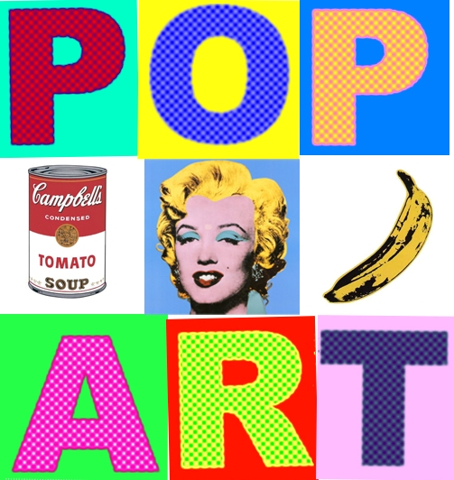

Slide 2
What is POP ART?
Pop art is a fun form of art.
Pop art started after the second world war and was very different to the very serious fine art of the past.

Slide 3
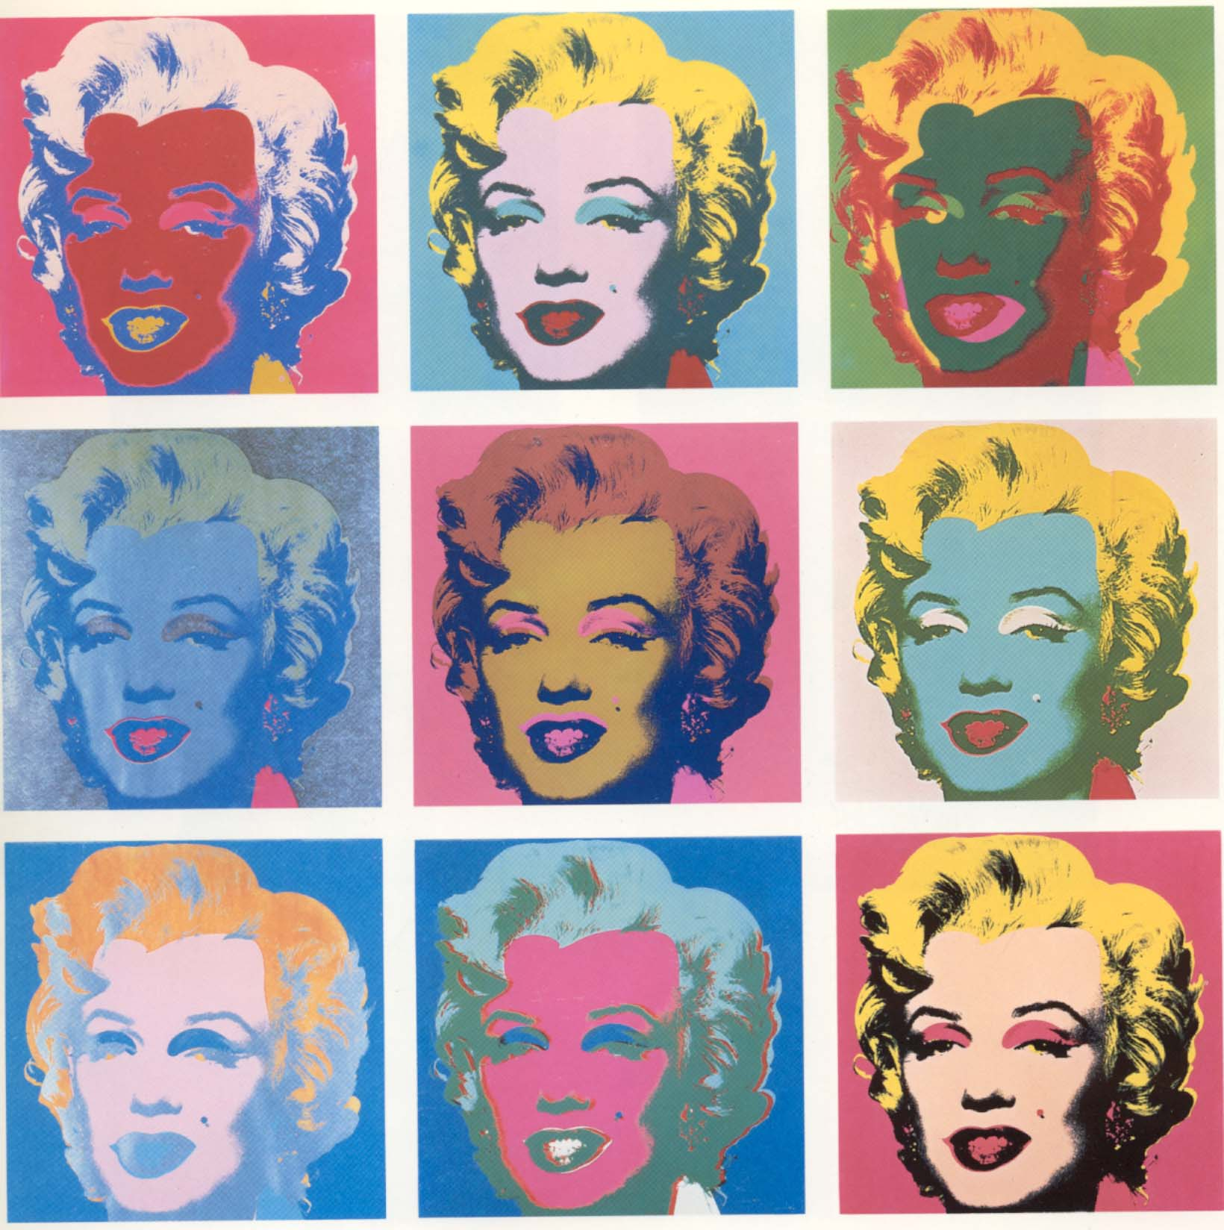
Pop art often uses images that are popular in the modern world such as...
Famous celebrities like movie stars...

Slide 4
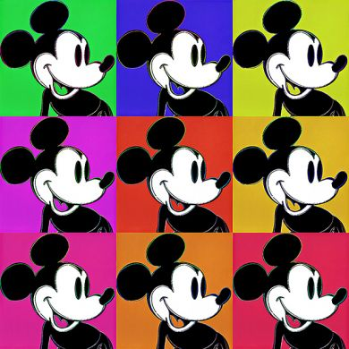
Disney characters...

Slide 5
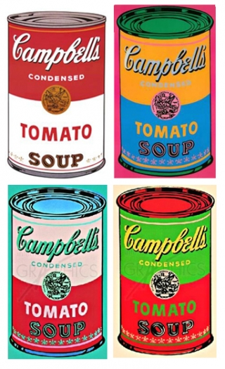
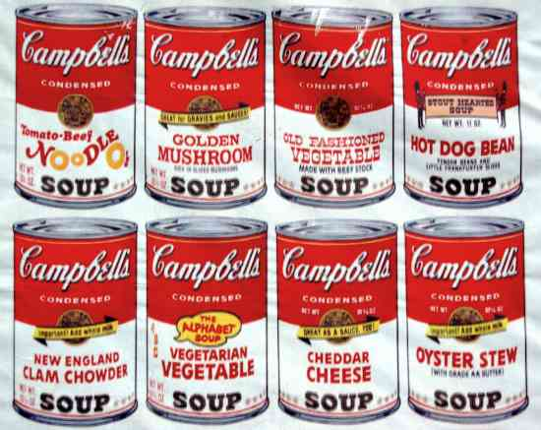
Every day objects that might be found around the home were also made the focus of works of art. Items such as...
Soup cans...

Slide 6
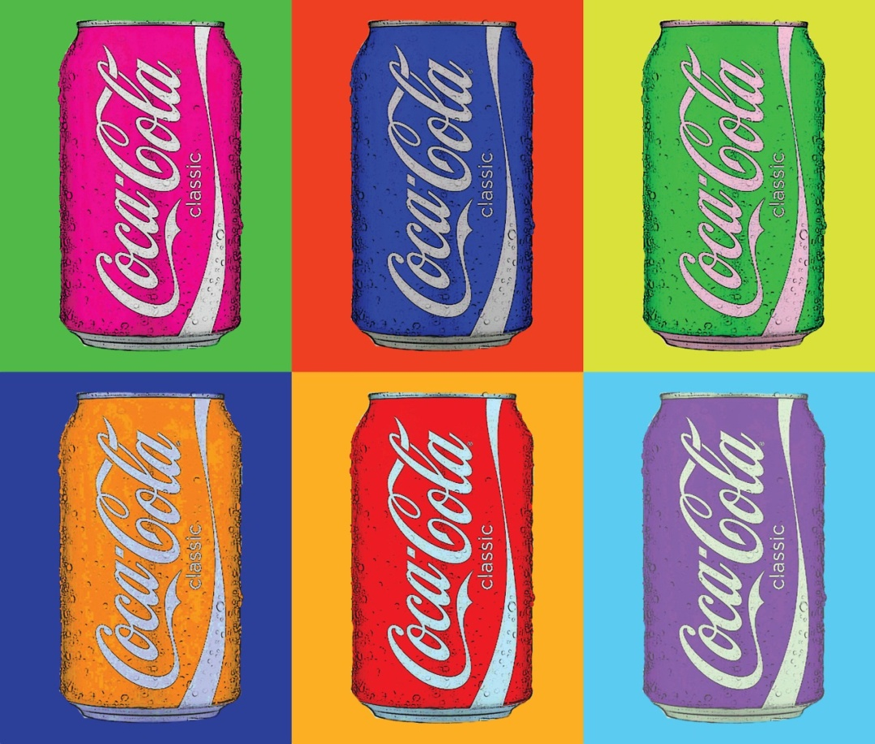
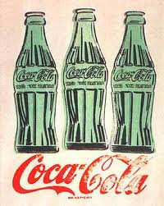
Soft drinks...

Slide 7
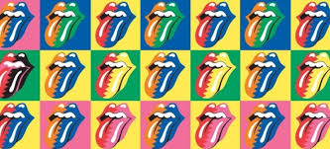
As you can see, in many forms of pop art, the items are drawn repeatedly with different colours and textures each time.

Slide 8


Slide 9
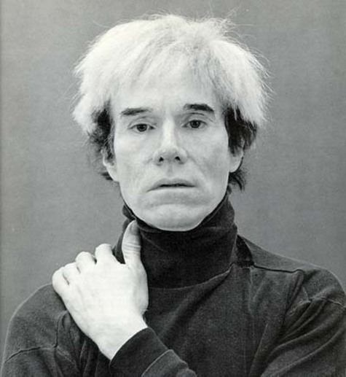
One of the most famous pop artists is called Andy Warhol.
Read Andy Warhol facts here:
http://primaryfacts.com/818/10-andy-warhol-facts/

Slide 10
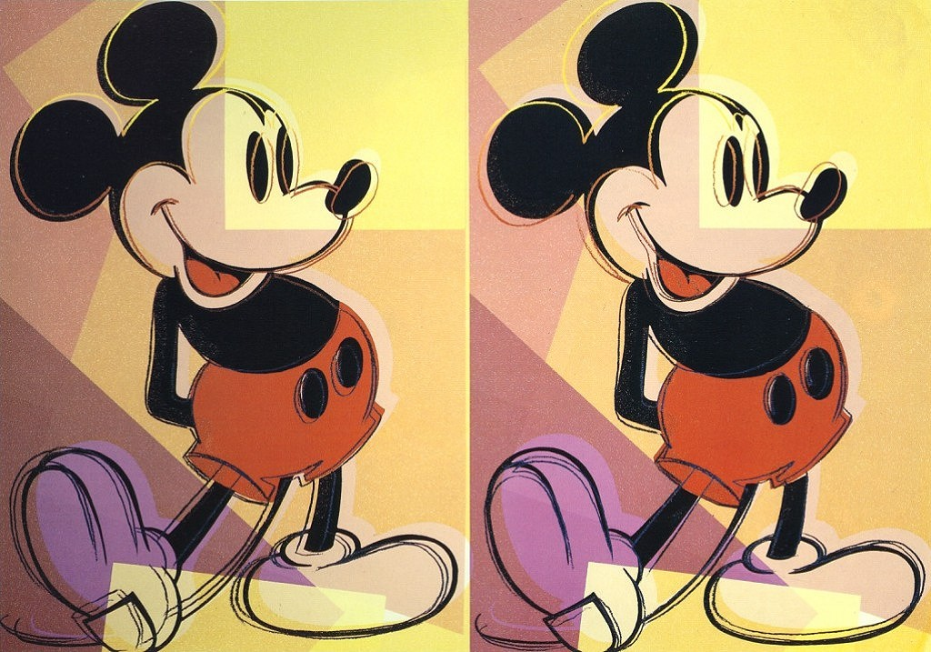
Warhol produced these famous pieces of pop art.

Slide 11
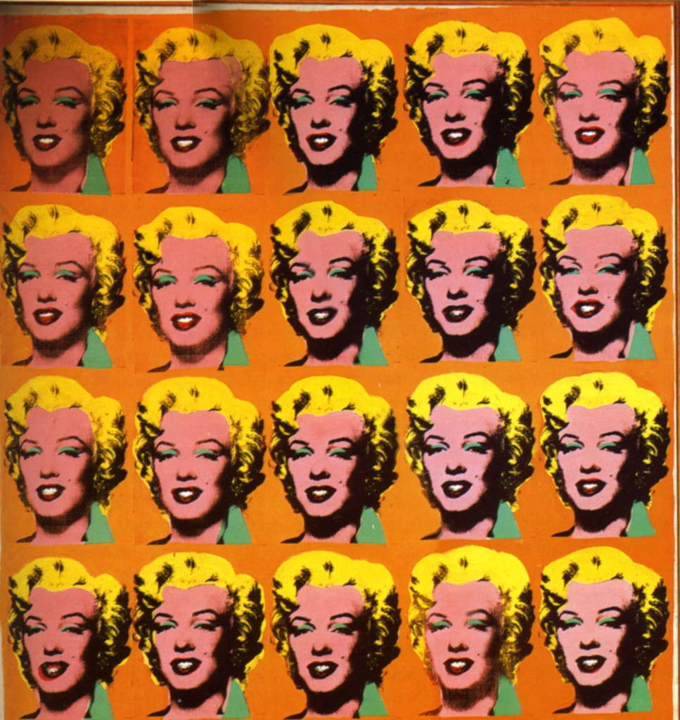

Slide 12
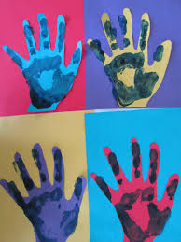

Slide 13
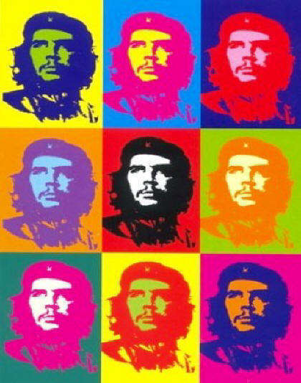

Slide 14
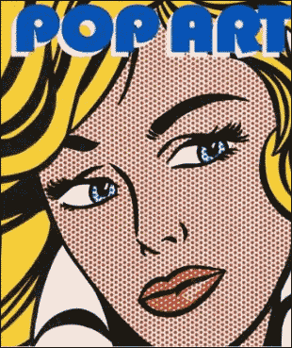
Pop art works also include elements of popular culture such as newspapers or magazines or comics.

Slide 15
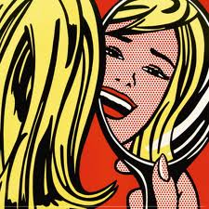

Slide 16
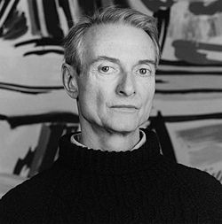
A famous pop artist who worked in this comic strip style is called
Roy Lichtenstein.
The following slides show some examples of his work.

Slide 17
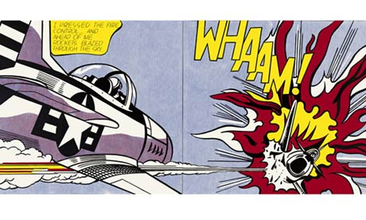

Slide 18
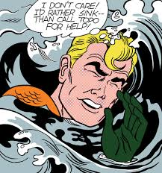

Slide 19
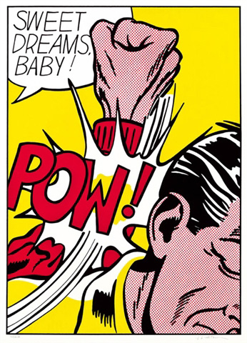
Words were also given the ‘comic strip’ effect by Lichtenstein !

Slide 20
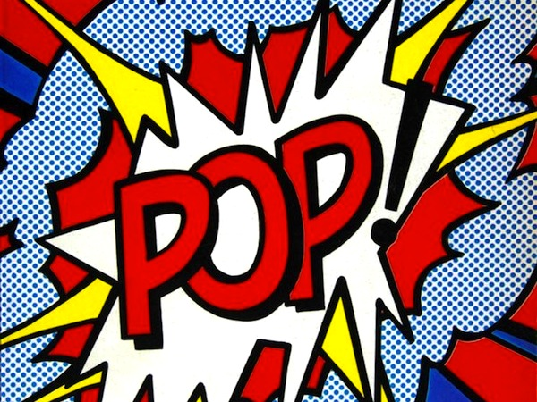

Slide 21
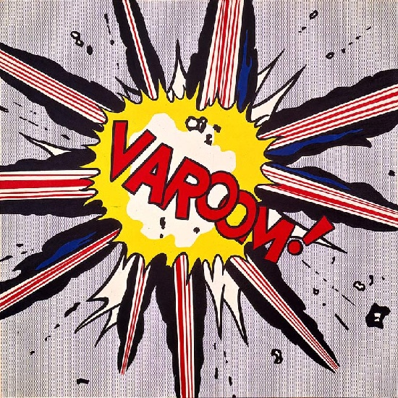

Slide 22
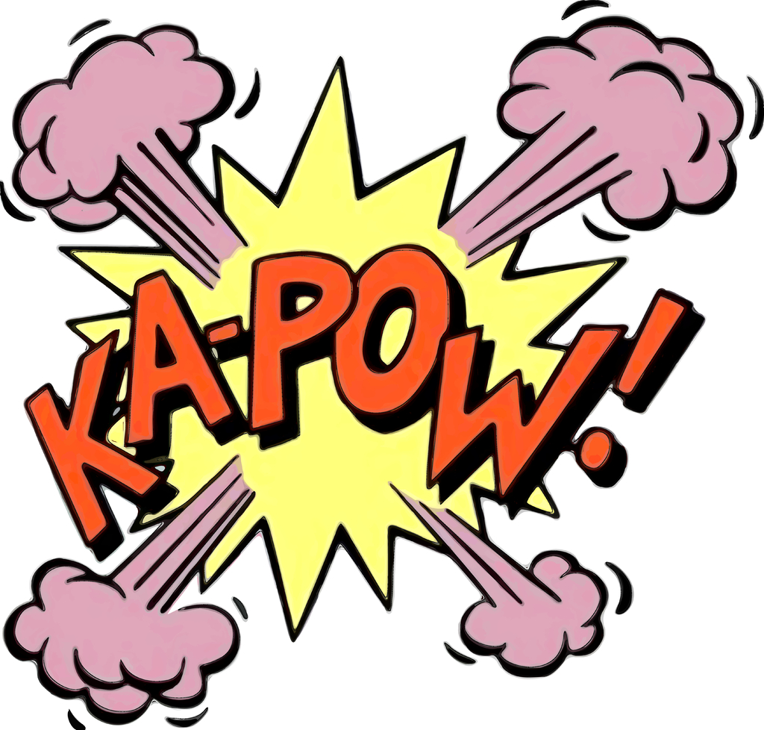

Slide 23
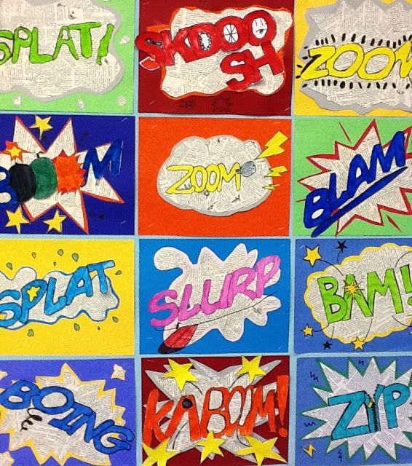
Today, we are going to create our own comic strip style ‘pop art’ words!

Slide 24
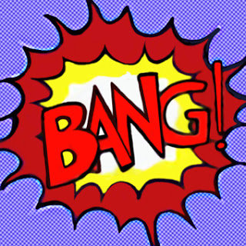
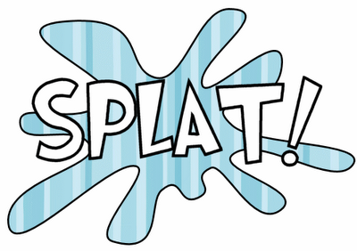
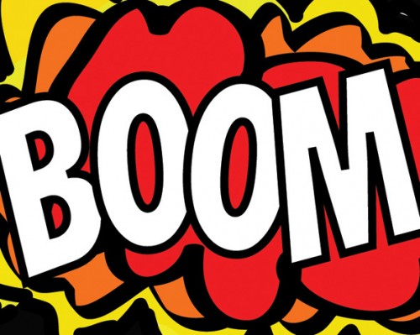
First, choose a word!

Slide 25
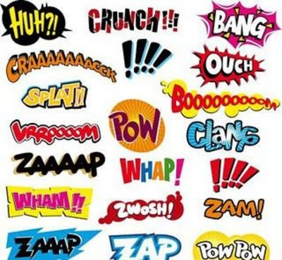

Slide 26
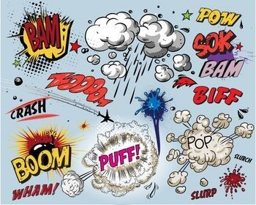

Slide 27
Now follow these instructions!
http://artisandesarts.blogspot.co.uk/2011/11/onomatopoeia-art.html?m=1

Slide 28
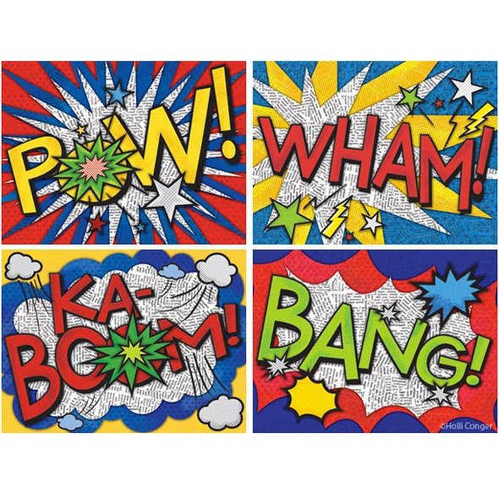
Your word will look something like this when it is finished!

